Slide 1
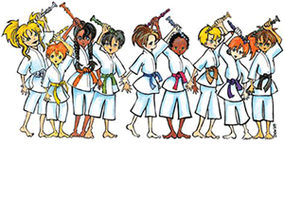
Recorder Karate 2
For
Odessa Wildcats

Slide 2
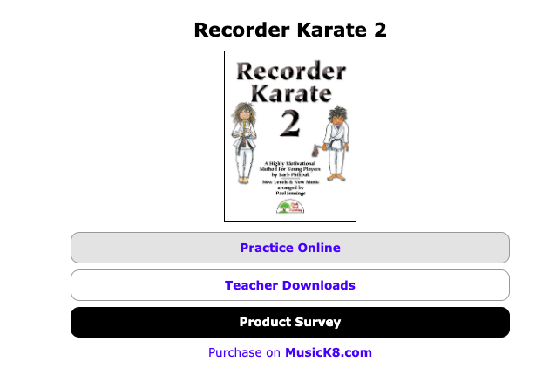
Welcome to Recorder Karate 2!
You can find the accompaniments to the following songs online at:
https://www.recorderdojo.com/welcome.php
Click on Practice online and enter the following:
Username- karate2
Password- blackb3lt

Slide 3
10. Pink Belt

Slide 4
11. Multicolored Belt

Slide 5
12. Teal Belt

Slide 6
13. Silver Belt

Slide 7
14. Baby Blue

Slide 8
15. Mint Green

Slide 9
16. Maroon

Slide 10
17. Fuschia

Slide 11
18. Hunter Green

Slide 12
19. Lavender

Slide 13
20. Blue BEAD

Slide 14
21. Red BEAD

Slide 15
22. Black BEAD

Slide 16
23. Silver BLING

Slide 17
24. Dark Blue BLING

Slide 18
25. Green BLING

Slide 19
26. Purple BLING

Slide 20
27. Pink BLING

Slide 21
28. Turquoise BLING

Slide 22
29. GOLD BLING

Slide 23
30. Music Note CHARM

