Slide 1
Florida Panther Exam
20 Questions to
Test your Florida panther I.Q.
Purr-fessor Lotz
Mark Lotz, Panther Biologist
Florida Fish & Wildlife Conservation Commission

Slide 2
What color are Florida panthers?
Black
Pink
Tan
Plaid

Slide 3
What color are Florida panthers?
Black
Pink
Tan
Plaid

Slide 4
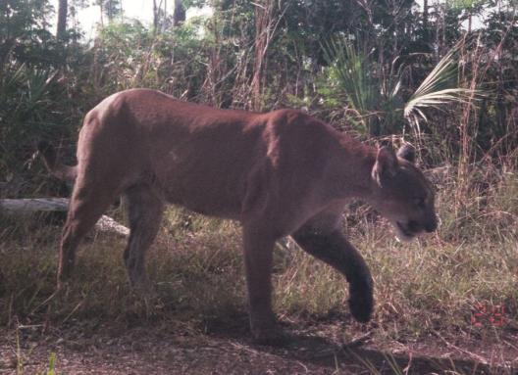
Shades of tan
NOT black
Jaguars and leopards have black phases
Black cats commonly called “panthers”

Slide 5
Where do Florida panthers range?
Florida
The Everglades and Big Cypress physiographic regions
Less than 5% of its historic range
All of the above

Slide 6
Where do Florida panthers range?
Florida
The Everglades and Big Cypress physiographic regions
Less than 5% of its historic range
All of the above

Slide 7
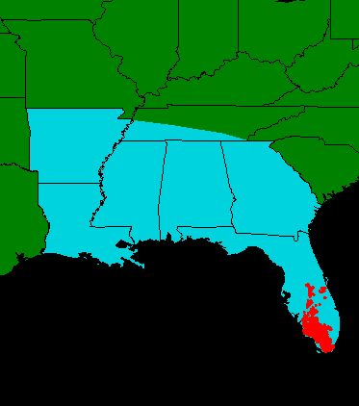
Breeding
population in
south FL
No females north
of river since 1972
Males in central
FL, beyond
2008
Former Range
Current Range

Slide 8
The Florida panther is most closely related to
Mountain lions
Cougars
Pumas
None of the above

Slide 9
The Florida panther is most closely related to
Mountain lions
Cougars
Pumas
None of the above

Slide 10
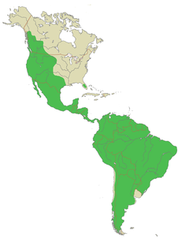
Panther, puma, cougar, mountain lion are all used to describe Puma concolor.
The Florida panther is a subspecies of puma.
Puma concolor range

Slide 11
How much do adult Florida panthers weigh?
25-45 pounds
55-150 pounds
175-250 pounds
300 pounds

Slide 12
How much do adult Florida panthers weigh?
25-45 pounds
55-150 pounds
175-250 pounds
300 pounds

Slide 13
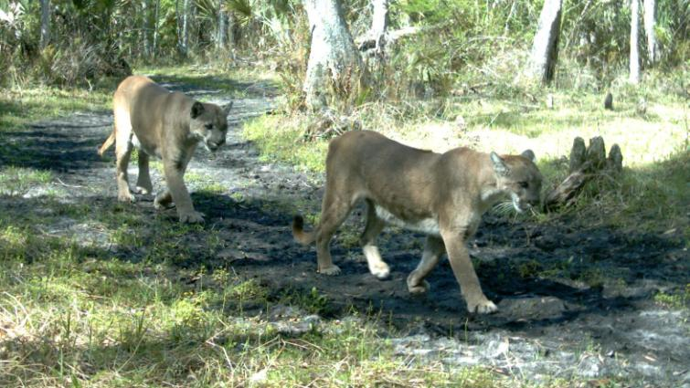
Males ~ 130 lbs
Females ~ 80 lbs
Photo courtesy of Lee Reed

Slide 14
Panthers live to be ______ years old in the wild.
5
10
18
30

Slide 15
Panthers live to be ______ years old in the wild.
5
10
18
30

Slide 16
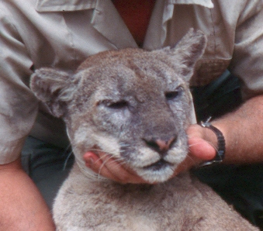
Males ~ 10 years old
Females ~ 15 years old

Slide 17
Panthers preferred food items include
Deer and hogs
Armadillos and raccoons
People
A and B

Slide 18
Panthers preferred food items include
Deer and hogs
Armadillos and raccoons
People
A and B

Slide 19
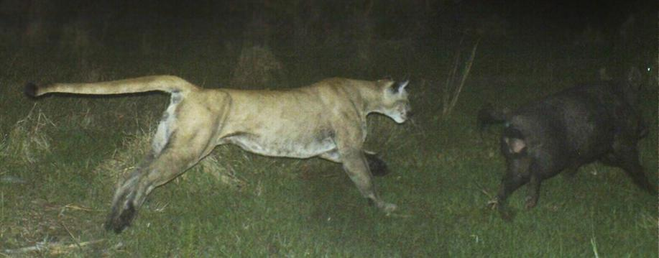
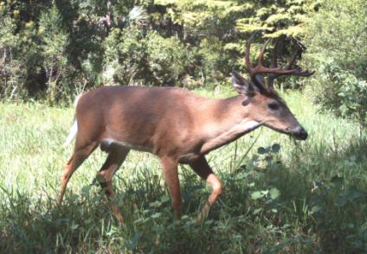
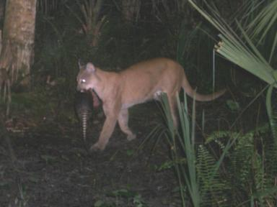

Slide 20
Panthers are mainly solitary except during mating and when females are raising kittens.
True
False

Slide 21
Panthers are mainly solitary except during mating and when females are raising kittens.
True
False

Slide 22
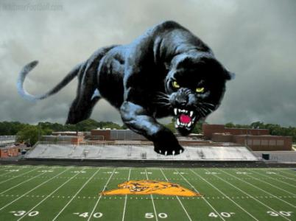
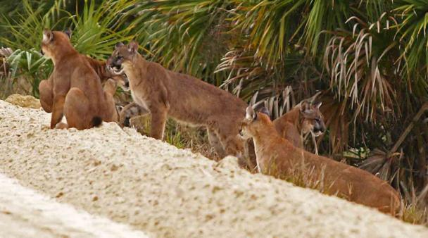
My high school has
panther pride...
…but there is no such thing as a pride of panthers.

Slide 23
What time of year do Florida panthers breed?
Summer
Winter
Spring
Year round

Slide 24
What time of year do Florida panthers breed?
Summer
Winter
Spring
Year round

Slide 25
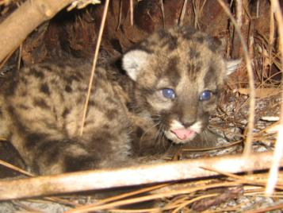
Males
mature 3 yrs
Females
mature 1.5 yrs
Gestation 3 mo

Slide 26
Florida panthers give birth to how many kittens?
1-4
2-3
8
6

Slide 27
Florida panthers give birth to how many kittens?
1-4
2-3
8
6

Slide 28
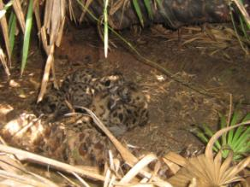
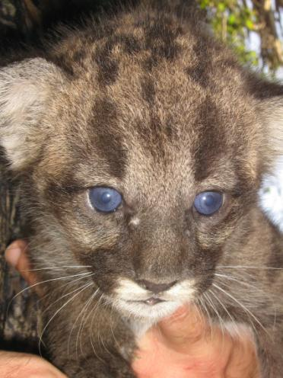
Den in palmetto thickets
Every 2 yrs
Kittens disperse 9-18 mo

Slide 29
What habitat do Florida panthers use?
Pine forests and hardwood hammocks
Cypress swamps
Back yards
All of the above

Slide 30
What habitat do Florida panthers use?
Pine forests and hardwood hammocks
Cypress swamps
Back yards
All of the above

Slide 31
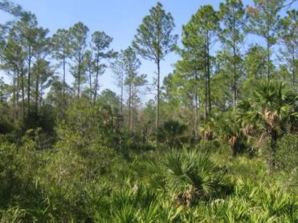
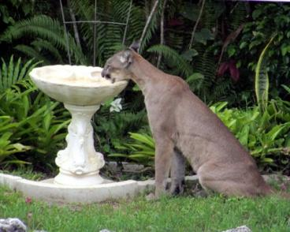
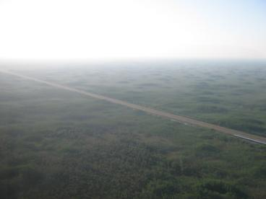
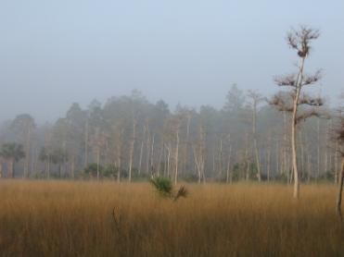
Habitat generalists

Slide 32
A Florida panthers home range can be up to
2 sq mi.
20 sq. mi.
200 sq. mi.
2000 sq. mi.

Slide 33
A Florida panthers home range can be up to
2 sq mi.
20 sq. mi.
200 sq. mi.
2000 sq. mi.

Slide 34
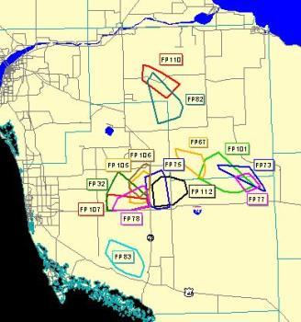
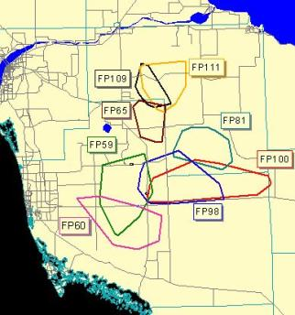
Males
Defend territories
Encompass many females
Females
Don’t defend
Share with female offspring

Slide 35
The Florida panther is
Endangered
Threatened
Species of special concern
None of the above

Slide 36
The Florida panther is
Endangered
Threatened
Species of special concern
None of the above

Slide 37
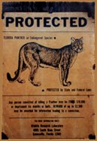
1950: Game species
1958: Listed
endangered by FL
1967: Listed
endangered by U.S.
1973: Protected
under ESA

Slide 38
Current Population Range
100-180
Declined in 1900’s
May have been fewer than 20
Genetic restoration helped rebound

Slide 39
The biggest threat to the Florida panthers continued survival is
Inbreeding
Cars
Habitat loss and fragmentation
Climate change

Slide 40
The biggest threat to the Florida panthers continued survival is
Inbreeding
Cars
Habitat loss and fragmentation
Climate change

Slide 41
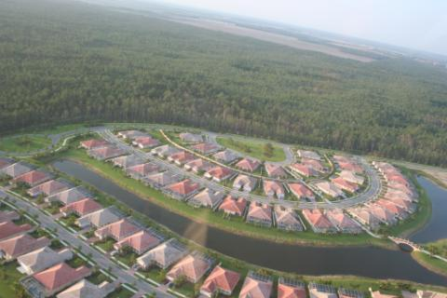
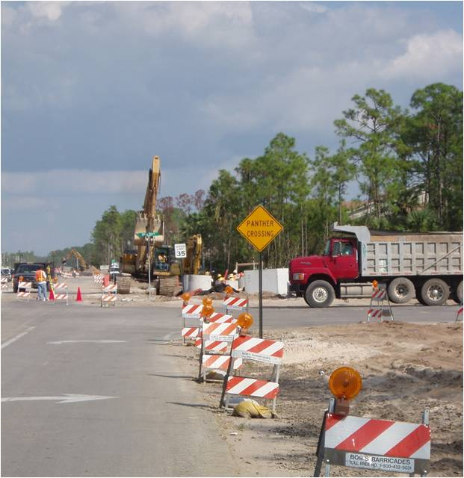
Where’s a panther to go?

Slide 42
Because the Florida panther population is isolated, inbreeding has caused
Kinked tails
Cowlicks
Holes in the heart
All this and more

Slide 43
Because the Florida panther population is isolated, inbreeding has caused
Kinked tails
Cowlicks
Holes in the heart
All this and more

Slide 44
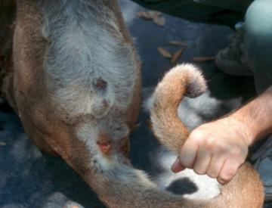
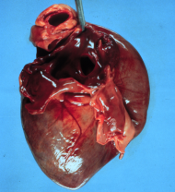
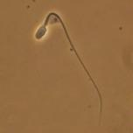
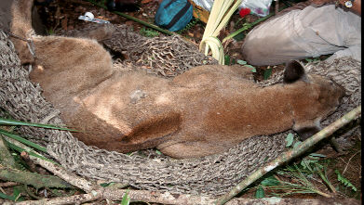
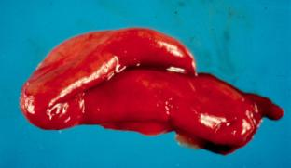

Slide 45
Genetic restoration was meant to
Increase genetic variability
Mimic historical gene flow
Prevent extinction
All of the above

Slide 46
Genetic restoration was meant to
Increase genetic variability
Mimic historical gene flow
Prevent extinction
All of the above

Slide 47
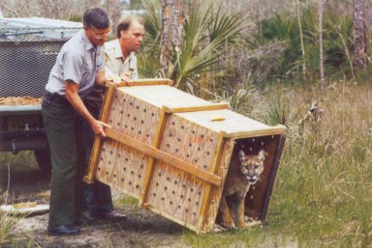
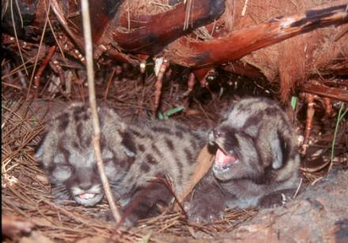
8 female Texas pumas released 1995
Closest population that historically interbred
Project successful!

Slide 48
What plans are in place to manage human-panther conflicts?
Collier County Disaster Management Plan
Plan? What plan?
People are allowed to do whatever they want to
The Interagency Florida Panther Response Plan

Slide 49
What plans are in place to manage human-panther conflicts?
Collier County Disaster Management Plan
Plan? What plan?
People are allowed to do whatever they want to
The Interagency Florida Panther Response Plan

Slide 50
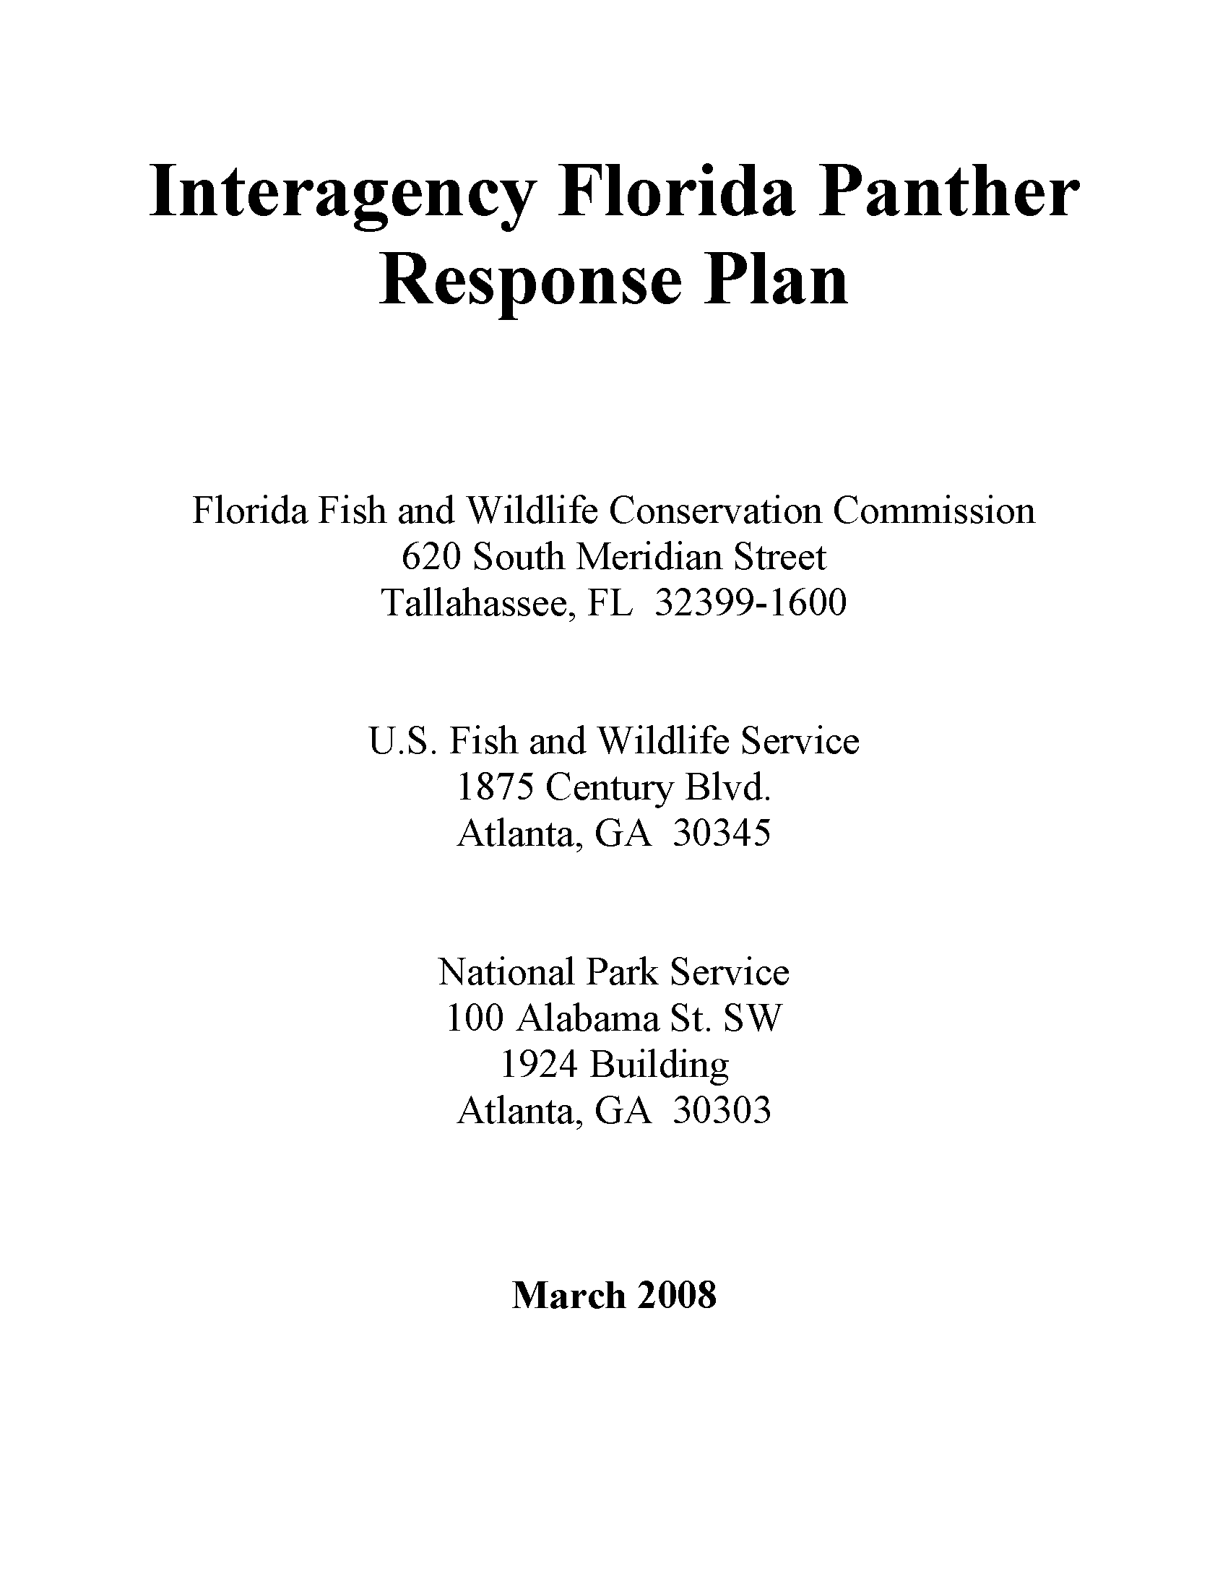
Human-Panther Interactions
Sighting
Encounter
Incident
Threat
Attack
Depredations
Notes:
Response Team established 2004. Response Plan 2005. Environmental Assessment for Plan finalized 2008.

Slide 51
If you see a panther in the wild you should
Enjoy the experience from a safe distance.
Trip your hiking partner and run away as fast as you can.
Approach the panther so you can get a better picture
Call 911

Slide 52
If you see a panther in the wild you should
Enjoy the experience from a safe distance.
Trip your hiking partner and run away as fast as you can.
Approach the panther so you can get a better picture
Call 911

Slide 53
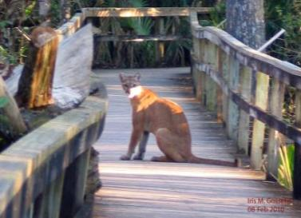
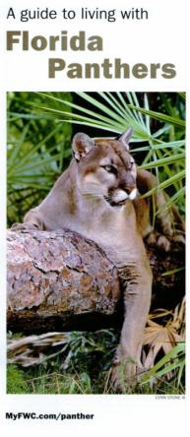
Presence does not constitute a threat
Panthers should not be feared but caution should be exercised as with any wild animal.
Follow safety guidelines

Slide 54
The best thing to do to protect your pets and hobby farm animals from a panther attack is to
Chain them up so the panther can’t drag them away
Use guard animals such as dogs or donkeys
Keep them in a well lit area
House them in a predator safe enclosure, especially at night when panthers are typically most active.

Slide 55
The best thing to do to protect your pets and hobby farm animals from a panther attack is to
Chain them up so the panther can’t drag them away
Use guard animals such as dogs or donkeys
Keep them in a well lit area
House them in a predator safe enclosure, especially at night when panthers are typically most active.

Slide 56
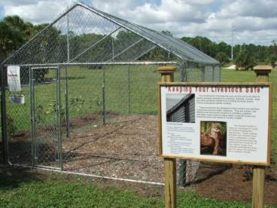
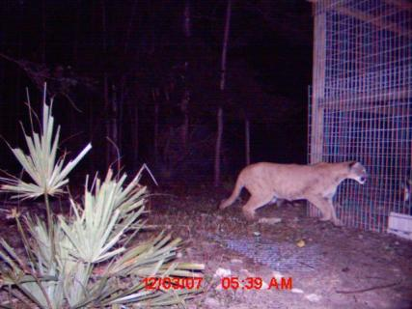
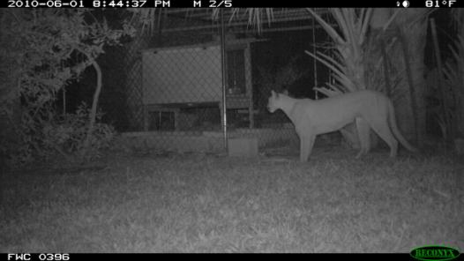
It really is that simple.

Slide 57
How are Florida panthers captured for study?
Highly specialized proprietary techniques
Ancient Chinese secret
Dogs, because everyone knows cats are afraid of dogs
Traps baited with catnip

Slide 58
How are Florida panthers captured for study?
Highly specialized proprietary techniques
Ancient Chinese secret
Dogs, because everyone knows cats are afraid of dogs
Traps baited with catnip

Slide 59
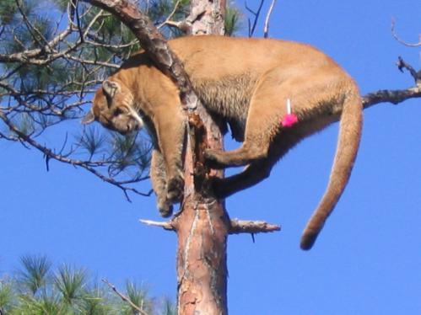
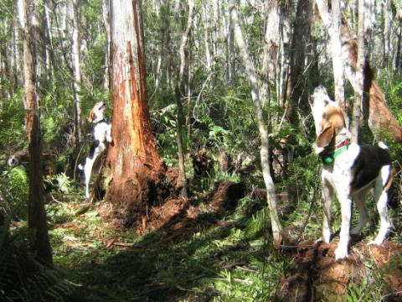
Dogs tree the panther and hold it there until our arrival

Slide 60
Florida panther research and management activities conducted by the Florida Fish and Wildlife Conservation Commission are funded by
Grants
Viewers like you
Taxes
Sales of the Florida panther license plate

Slide 61
Florida panther research and management activities conducted by the Florida Fish and Wildlife Conservation Commission are funded by
Grants
Viewers like you
Taxes
Sales of the Florida panther license plate

Slide 62
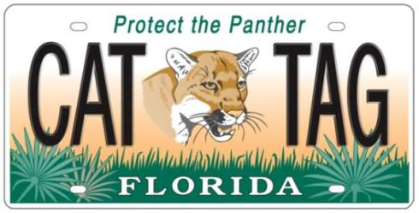
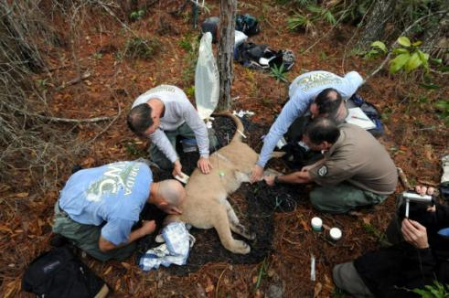
Florida Panther Research and Management Trust Fund
$25 extra, 85% goes into trust fund
Program funded 100% through plate sales

Slide 63
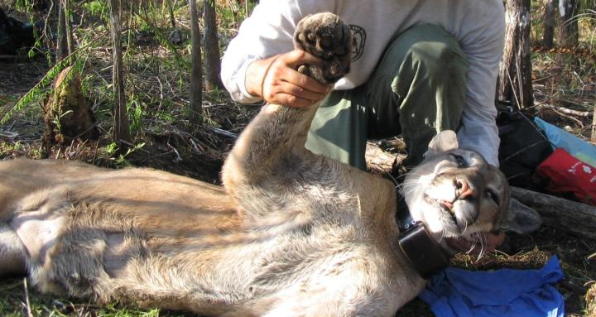
Questions?
www.floridapanthernet.org
Mark Lotz

Slide 64
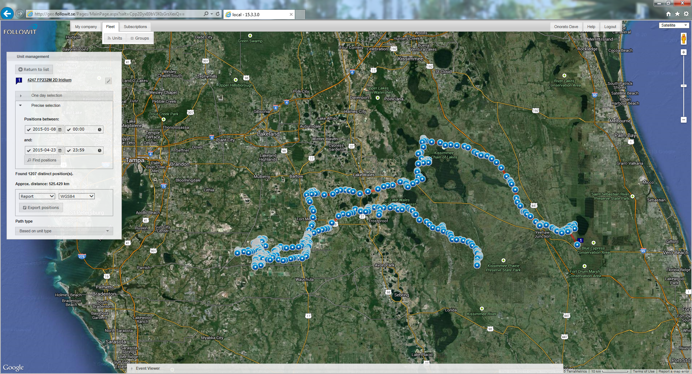
FP232
The new FP62?
Released on Kissimmee Prairie Preserve State Park on 1/7/2015.
Hit by vehicle in Ft. Meade on 4/15/2014 during a lunar eclipse.
Returned to Ft. Meade within a week then cut back across the state.

