Slide 1
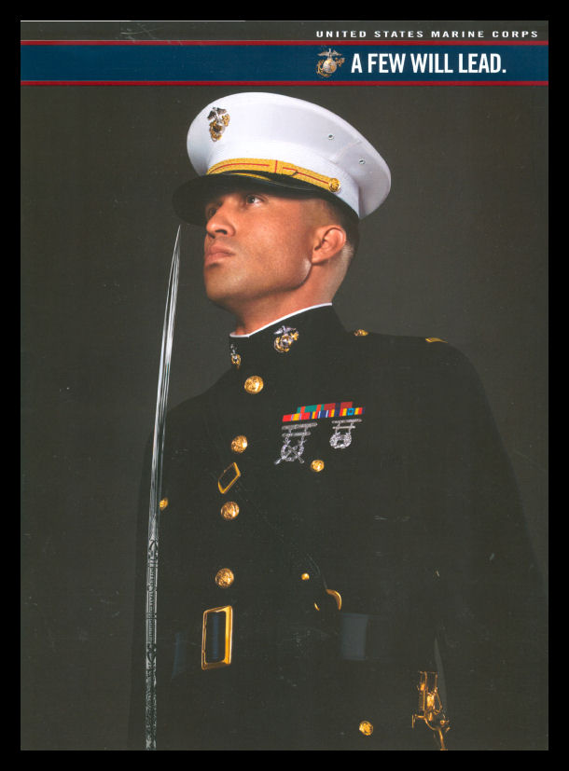
MARINE CORPS
NAVAL RESERVE OFFICER TRAINING CORPS
(NROTC)
SCHOLARSHIP
Notes:
Ronald Reagan Quote: Some people spend an entire lifetime wondering if they made a difference in the world. But, the Marines don’t have that problem.

Slide 2
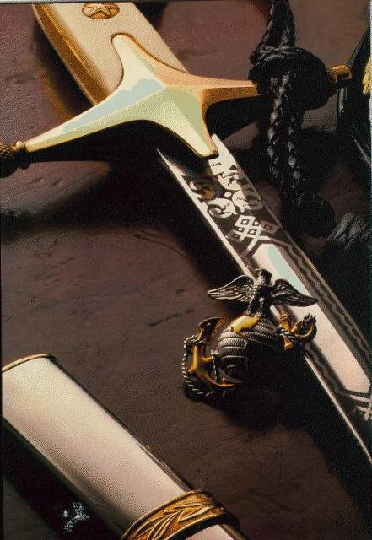
NROTC Mission
To develop midshipmen mentally, morally, and physically and to imbue them with the highest ideals of duty, loyalty and with the core values of honor, courage and commitment in order to commission college graduates as naval officers who possess a basic professional background, are motivated toward careers in the naval service and have potential for future development in mind and character so as to assume the highest responsibilities of command, citizenship and government.

Slide 3
NROTC SCHOLARSHIP
The NROTC program provides a full tuition scholarship.
In addition, educational fees, uniforms, and a $250 per month tax-free subsistence allowance is paid to students on scholarship while in attendance at the university as a freshman, increasing to -$300.00 a month for second year
-$350.00 a month for third year
-$400.00 a month for fourth year
The students are also given a $750 textbook stipend every year.
The NROTC program also pays for scholarship students’ transportation from home to summer cruise training.
Altogether, a four year period of full scholarship can amount to $180,000

Slide 4
Complete the online application:
- https://netfocus.netc.navy.mil.
- Selection Marine Option.
- Contact local Marine Recruiting Station and run a Physical Fitness Test.
- Turn in Official Transcripts, SAT/ACT Score, Copy of Birth Certificate, Physician Approval, Parental Approval, Minimum of two Teacher and a Counselor Recommendations
HOW TO APPLY FOR YOUR SCHOLARSHIP

Slide 5
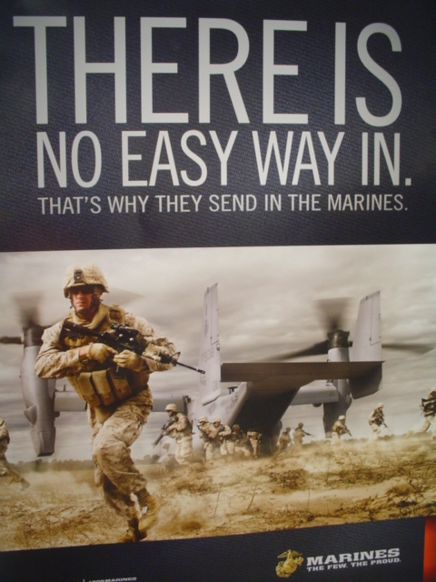
QUALIFICATIONS
• You must be a United States citizen.
• You must be at least 17 years old, have less than 30 college credits, and not be enrolled in college.
• You must be medically qualified to meet Marine Corps standards.
• Minimum test scores:
SAT combined score of 1000 or
ACT composite score of 22 or
ASVAB score of 74
• You must take a Physical Fitness Test (PFT)
3 mile run
Pull ups/pushups
Crunches
Notes:
Good afternoon, General.

Slide 6
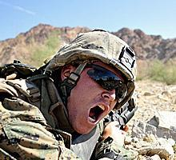
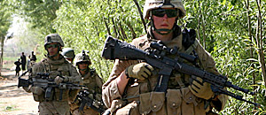
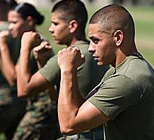
What do you think?
NROTC Marine Option
What is the Marine Corps?

Slide 7
CAPABILITIES
The Marine Corps has been America’s expeditionary force in readiness since 1775. We are forward deployed to respond swiftly and aggressively in times of crisis.
We are global leaders, developing expeditionary doctrine and innovation that set the example, and leading other countries’ forces and agencies in multinational military operations.
These unique capabilities make us “First to Fight,” and our nation’s first line of defense.
“WE WILL BE MOST READY WHEN OUR NATION IS LEAST READY”

Slide 8
FIGHTING PHILOSOPHY
We are the nation’s elite military branch. We are the President’s 911 force, ready to go anywhere in the world, at any time.
Every Marine is a rifleman, trained first as a disciplined warrior regardless of occupational specialty.
Our combined arms approach multiplies the Marine Corps' strengths by bringing our land, air and sea forces together to achieve every mission.
This is the key to winning battles.

Slide 9
National Selection Board Dates
Early Board :
Selection Board meets November 2022
Packages must be completed by October 2022
Results released December 2022
Regular Board:
Selection Board meets February 2023
Packages must be complete by January 2023
Results released early March 2023

