Slide 1
zearn.org
Notes:
Opening (slides 1-12): 12 minutes
Hi everyone! I am so excited to be here with all of you today!
My name is Corrine, and prior to joining Zearn I was the principal of an elementary school for many years.

Slide 2
Zearn Math is a top-rated math curriculum that personalizes learning for each student.
Notes:
Zearn Math is a personalized K-5 curriculum that meets the needs of each student, every day, so all children can learn and love math.

Slide 3
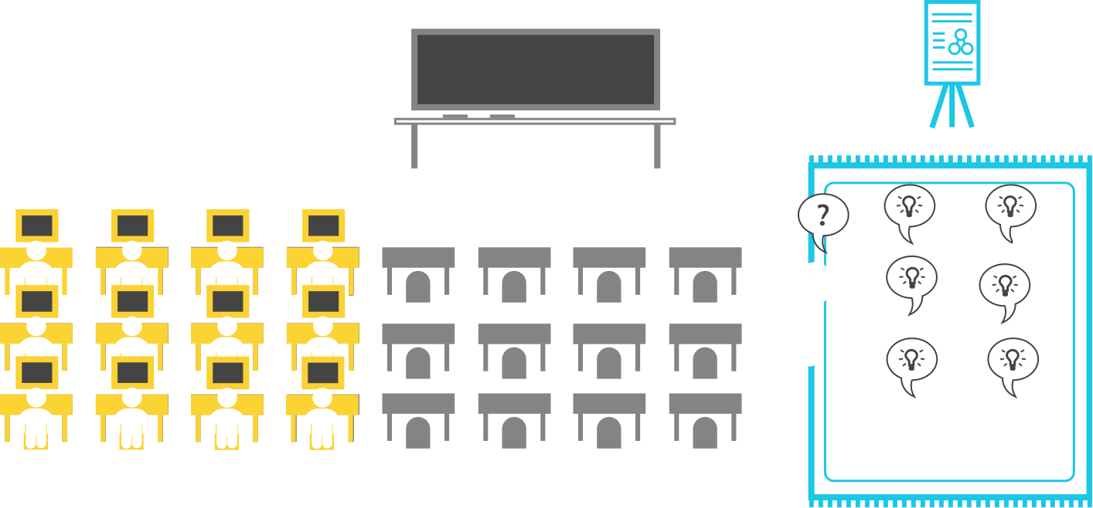
Students learn in a personalized way, rotating between learning independently and in small groups, every day.
Notes:
When you combine daily fluency and word problems <ANIMATES>,
Independent Digital Lessons <ANIMATES>, and SMALL GROUP INSTRUCTION <Animates> you have the key parts of a Zearn Math Block.
To stay on track to complete all grade level content, every student should complete 4 digital lessons each week and 4 small group lessons with their teacher.
Keep in mind that independent learning and small group instruction are designed to be parallel learning experiences, where students learn content in two ways.
For some kids, the small group lesson may be a bit ahead of what they learned in their digital lessons, while for others, the small group lesson may be something they’ve already started to learn. Regardless of where students are in the digital lesson sequence, small group instruction gives them the chance to learn concretely and apply what they’ve learned so they can get to deep understanding.

Slide 4
Let’s take a look at what children experience when learning independently.
Notes:
Then, students split into two groups — one group starts with independent digital lessons.
When students work at this station, they use their devices, headphones, and student notes to complete their digital lessons. Each lesson takes about 30 minutes, and students progress at their own pace. Keep in mind some kids will take a bit longer, and other kids may move more quickly.

Slide 5
1st Grade

Slide 7
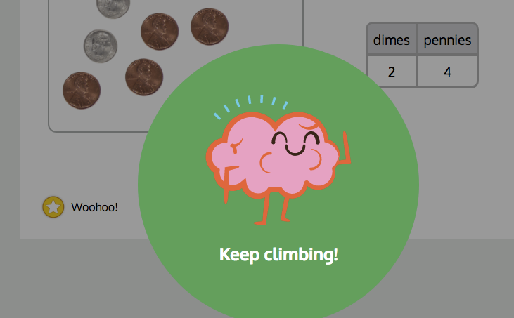
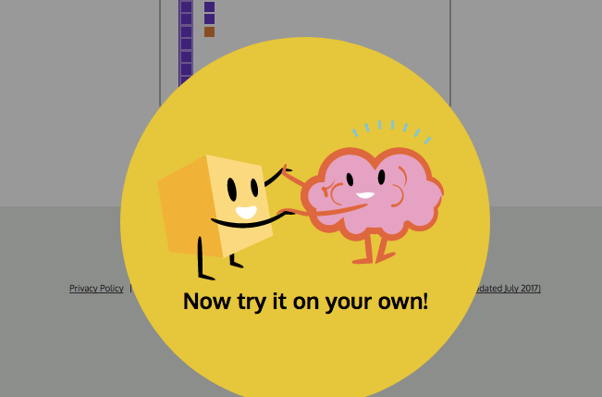
Students are reminded throughout to keep trying and work through challenge.
Notes:
http://help.zearn.org/paper-and-pencil-transfer/printed-materials
Independent Digital Lessons prompt students to complete guided Students Notes to help transfer learning and strengthen rete

Slide 8
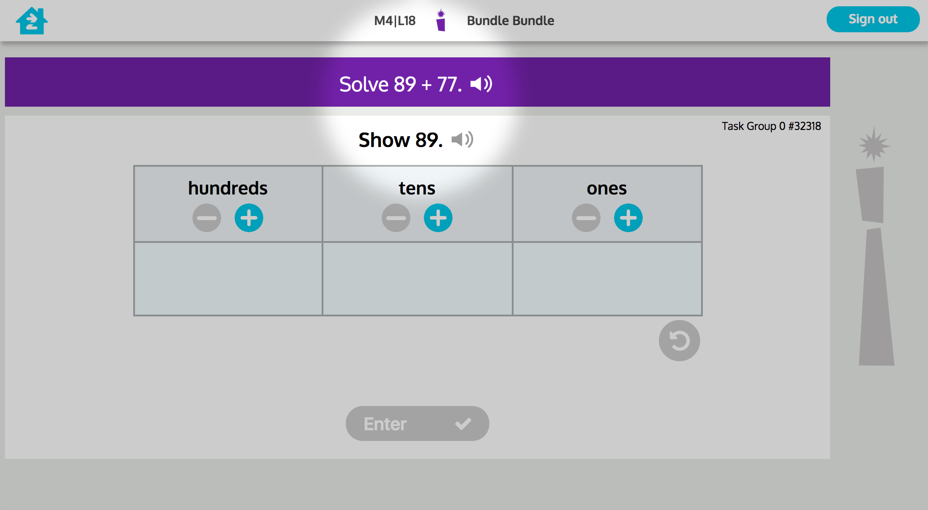
Text can be read aloud.
Notes:
http://help.zearn.org/paper-and-pencil-transfer/printed-materials
Independent Digital Lessons prompt students to complete guided Students Notes to help transfer learning and strengthen rete

Slide 9
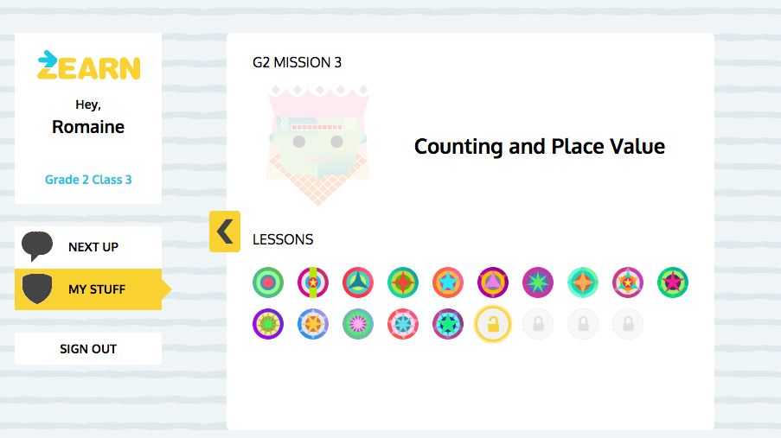
And, when your child completes a lesson they celebrate their hard work.
Notes:
http://help.zearn.org/paper-and-pencil-transfer/printed-materials
Independent Digital Lessons prompt students to complete guided Students Notes to help transfer learning and strengthen rete

Slide 10
Here are some questions to ask your child to support their learning with Zearn Math!
What did you discuss with your teacher and friends in math small group time?
What concrete materials did you get to learn with in Small Group today?
What are your favorite parts of a Digital Lesson?
When you get a challenging problem, how do you work through it?
How many Digital Lesson badges have you earned?
Notes:
We’re so excited to share Zearn PD with you today.
Here’s the plan for our half-hour together. We’ll start by talking about what PD has looked like in the past and why digital pd became a pressing need.Then we’ll talk about what we’re offering for the 17-18 school year - what we created and why we made it this way. Finally, we’ll demo in the product so you’ll get to see a part of ZearnPD as teachers will experience it.

Slide 11
zearn.org
Notes:
Opening (slides 1-12): 12 minutes
Hi everyone! I am so excited to be here with all of you today!
My name is Corrine, and prior to joining Zearn I was the principal of an elementary school for many years.

